Slide 1
GIT
By:Naim Latifi

Slide 2
Agenda
VCS (Version control systems)
What is GIT ?
GIT branching
GIT most common commands
An example scenario

Slide 3
Version control systems (VCS)
Easily management collaboration on a project by avoiding frustration of swapping files.
Ability to have unlimited number of developers working on the same code base.
Easily revert back your files if something happened.

Slide 4
VCS (cont’d)
There are two main categories of version control systems
Centralized version control systems
Distributed version control systems

Slide 5
Example for VCS

Slide 6
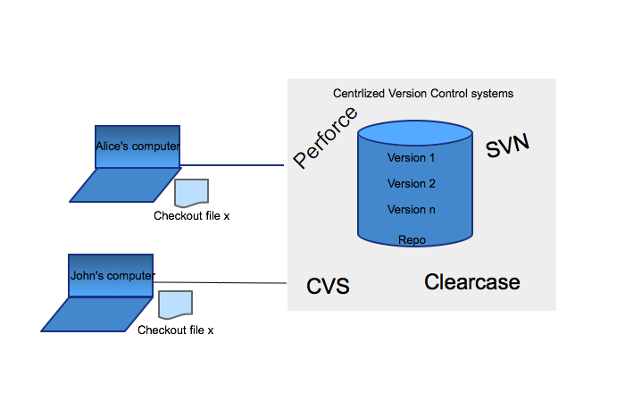
Centralized VCS

Slide 7
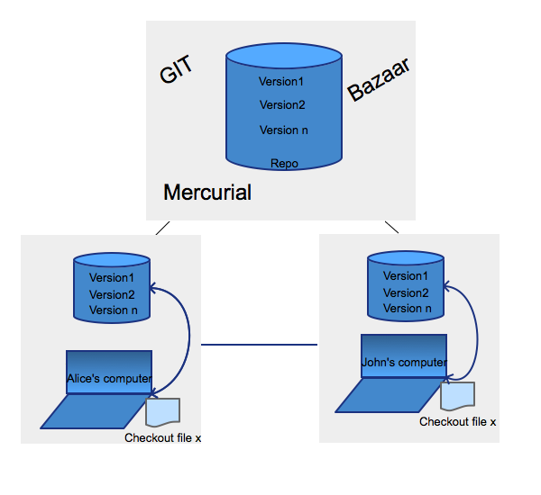
Distributed VCS

Slide 8
What is GIT ?
GIT is free and open source distributed system with the emphasis on speed and data integrity.
No centralized connectivity is needed.
Powerful and cheap branching with easy to merge.
Loosing work in your project is very very hard.

Slide 9
.git directory structure
.git
HEAD/ (A pointer to your current branch)
config/ ( contains all configuration preferences)
description/(description of your project )
Index/ (is used as staging area between working directory and repo)
logs/ (keeps records to changes that are made in ref)
objects/ (all data are stored here: commits, trees and tags )
hooks/ (shell scrips that are invoked after executing a command)
refs/ (holds your local branch remote branch and tags)

Slide 10

GIT state operation
.
Working directory
Staging area
GIT directory
(repo)
Remote repo
Stage files git add
commit files git commit
Push
Checkout
Fetch
Pull
Untracked
unmodified
modified
staged

Slide 11
GIT branching
Lightweight movable pointers for different commits.
By default the branch name is called “master”.
You can create as many branches as you need, merge them or delete (branches are CHEAP on GIT).
Merging of branches is easy.

Slide 12
Branch & merge - a case scenario !
.
8cf9d22
HEAD
M
Alice’s branches
master
file.x
CONFLICT
test
file.x
HEAD
fa00e44
eb97f66
HEAD
fa00e49
HEAD
fa00e49
79c6e38
a82bc13
HEAD
fa00e49
HEAD
Notes:
Merge the remote branch to local master branch *(if any conflicts fix them and commit)

Slide 13
GIT commits
ab3342
tree
.
Working directory
Staging area
Tree object
Blob-stores data
ab3342c
ab3354c
SHA-1 checksum
abffs42c
Commit - ad4435
Commit - ad5643
tree – ab3342
tree – 1csd32
author Alice
parent – ad4435
Message “test commit”
author ……
……………………
Commit – 637ddx
tree – 321dzr

Slide 14
GIT three way merge
It takes the two latest commits from branch (bb00e39, ab4532) and the most common ancestor of the two (bb00e39) and creates a new commit (bb00e39) after successful merge
Master branch
Master
Test branch
F44cad
bb00e39
bb00e39
bb00e39
ab00e50
ab4532
Test branch
Notes:
As Base it takes the base commit from where the test branch is branch off (bb00e39) the last commit of test branch (ab4532) and the latest commit from branch master (bb00e39) and moves the head Master as a result of three way merge

Slide 15
GIT rebasing
The major benefit of rebasing is that you get a much cleaner project history
Master branch
GIT will "undo" all commits on master that happened
after the lines began to branch out (common ancestor) and save
them temporarily
Test branch
Master
F44cad
bb00e39
bb00e398
ab00e50
ab4532
It then will integrate the commits
from our test branch, then the new commits on branch master are reapplied on top of integrated commits from branch Test
Test
Master
bb00e39
F44cad
bb00e39
ab00e50
ab00e51
bb00e398

Slide 16
GIT most common commands
INIT
CLONE
STATUS
ADD
CHECKOUT
COMMIT
LOG
REMOTE
FETCH
PUSH
PULL

Slide 17
GitHub
GitHub is a web based Git repository hosting service
GitHub Alternatives:
BitBucket
GitBucket

Slide 18
(cont’d )
$ git init
creates a local repository
$ git clone path_repi
Checkout a repository and create a local copy of it.

Slide 19
(cont’d)
$ git status
To see the state of your files (modified , added , remote..)
$ git add ”file_name”
add files to your staging area

Slide 20
(cont’d)
$ git checkout
Checkout a tracked file to untracked file. This command is also used for switching between branches
$ git commit –m ”message”
Commit a stage file

Slide 21
(cont’d)
$ git log
To get the history of your commits or commits made by someone else
$ git remote ’origin’
Shows the remote repository name that by default is origin

Slide 22
(cont’d)
$ git fetch ”remote_name”
Updates remote repository without merging with your local
$ git push ”remote_name
pushes your commits, branches etc. to remote repository

Slide 23
(cont’d)
$ git pull ”remote_name”
Updates remote repository and merge changes with your local repo

Slide 24



An example scenario
Origin
dsf
B
master
Remote repo
B
B
B
B
fetch
fetch
master
master
Boxes
Boxes
Local repo
Local repo
PUSH
push
B
Boxes
clone
B
Local repo
B
master
Boxes
Alice
John
George

Slide 25
Thank you for your time !

Slide 26

QUESTIONS

